Slide 1
SAUDI ARAMCO
STUDENT’S NAME
INSTITUTIONAL AFFILIATIONS

Slide 2
INTRODUCTION
Saudi Aramco started in 1933.
In 1933 it signed a treaty with Standard Oil Company of California.
After the treaty they formed a subsidiary named California Arabian Standard Oil Company (CASOC).
After surveying Saudi desert oil drilling commenced in 1935.
Success came when oil was found.
Commercial oil production started in “Prosperity Well.”
From that period until now Aramco has hit records in oil production.
Notes:
Headquartered in Dhahran, Saudi Arabia, the Saudi Arabian Oil Company (operating as Saudi Aramco) is the world’s largest integrated oil and gas company. Apart from hydrocarbon exploration, production, refining, distribution and shipping, the company also provides crude oil marketing services. It serves the global markets through its large network of offices, research and development centers, joint ventures and subsidiaries.

Slide 3
Types of FDI engaged by Saudi Aramco
Aramco utilizes horizontal and vertical FDI.
The company entered into agreements with other oil companies based in foreign countries.
Aramco utilized horizontal FDI to lower competition in foreign market
Horizontal FDI helps in gaining a certain market share foreign countries.
The company has also made efforts in establishing subsidiaries in foreign countries.
The company in 2016 signed a five year agreement with Chevron to further research for mutual benefits.
The company has also opened offices in the following places.

Slide 4
Types of FDI engaged by Saudi Aramco Cont..
Beijing, China.
Dhahran, Saudi Arabia (headquarter)
Houston, USA
London, UK
Malaysia
New Delhi, India
NewYork, USA
Seoul, South Korea
Singapore
The Hague, Netherlands
Tokyo, Japan
Xiamen, China

Slide 5
Host Country Evaluation
China is the host country for Saudi Aramco.
Saudi Aramco is based at Beijing, China.
The country since it reformed its economy in 1978, it has been recording a growth of 10% annually in its GDP.
China is currently a upper-middle income country and it is ranked the second in the world in terms of its economy.
China economic freedom score is 59.9 and this makes it assume 103 positions in terms of economic freedom as per 2020 index.

Slide 6
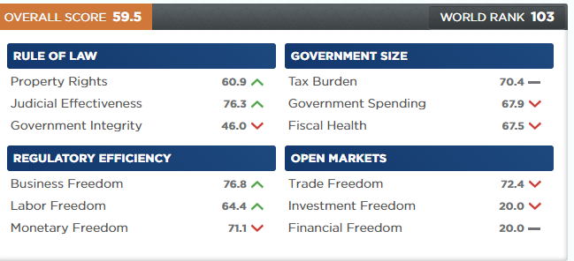
Host Country Evaluation Cont.….

Slide 7
Home Country Evaluation
Capital: Riyadh
Total Population: 33,699,947
Natural Increase: 1.8%
Density: 16 Inhabitants/km²
Urban Population: 83.8%
Ethnic Origins: Ethnic Arabs (90%) and Afro-Asians10%.
Official Language: Arabic
Headquarters based in Dhahran, Saudi Arabia.
Economic freedom score in Saudi Arabia is 62.4.
The Saudi Arabia economy is ranked 83rd freest as per 2020 index.

Slide 8
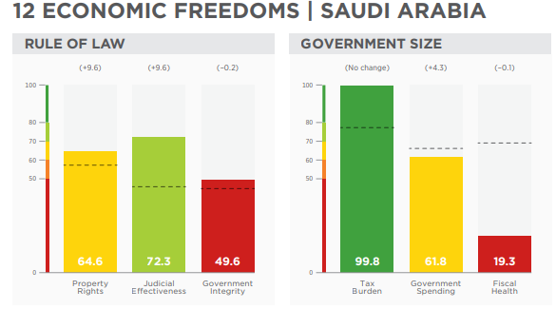
Home Country Evaluation Cont.…..
Population:1.4 billion
GDP (PPP):
  $25.3 trillion
  6.6% growth
  6.9% 5-year compound annual growth
  $18,110 per capita
Unemployment:
  4.4%
Inflation (CPI):
  2.1%
FDI Inflow:
  $139.0 billion

Slide 9
OPINION
Aramco utilizes a transnational strategy.
Saudi Aramco is represented in the following global energy markets, Asia, Europe and America.
Partnering with organizations in other nations has created markets for products.
Additional profits from the interests gained from sales of products has enabled growth of the company to a multinational level.
As a multinational organization, Saudi Aramco serves global market, solves global challenges and creates global impact.

Slide 10
References
Saudiaramco.com. (2020). Retrieved 7 June 2020, from https://www.saudiaramco.com/- /media/publications/corporate-reports/saudi-aramco-ara-2019- english.pdf?la=en&hash=FDBFE7887B74E816C493F09DA188F1151839A4CD.
Overview. Saudiaramco.com. (2020). Retrieved 7 June 2020, from https://www.saudiaramco.com/en/who-we-are/overview.

